Slide 1
DBMS Project
Fiber optics cable applications in the oil and gas
Bo Yun

Slide 2
Data requirement and description
Employee table : general employee information such as start time, position, years with the company.
Project table : Project ID, department name that handles this project, Client (ID) that is involved in this project, Profile indicating how important the specific project is, Job type indicating whether it is a crosswell frac or a production monitoring job, which are two main cutting-edge services that we provide.
Client : Contains how much we charge them per day in U.S dollar
Field data: Contains the following strain, temperature, pump data
- Strain data: Acoustic slow strain data
- Temperature data: Temperature measured in Fahrenheit degrees.
- Pump data: consists of timestamp, treating pressure(Pressure required to maintain pumping during fracking operation , slurry volume, and proppant concentration.

Slide 3
ER model
C_name
C_ID
Service
E_ID
Dname
Start_date
Client
Invoice
Employee
Years_with_company
m
n
Position
Involved in
Requested by
Ename
Dname
Duration
n
Fname
Lname
m
P_ID
Project
C_ID
Profile
m
Provides
Job_type
n
Strain
Temp
Field_data
PPA
P_ID
Time
TR_PRESS
SLUR

Slide 4
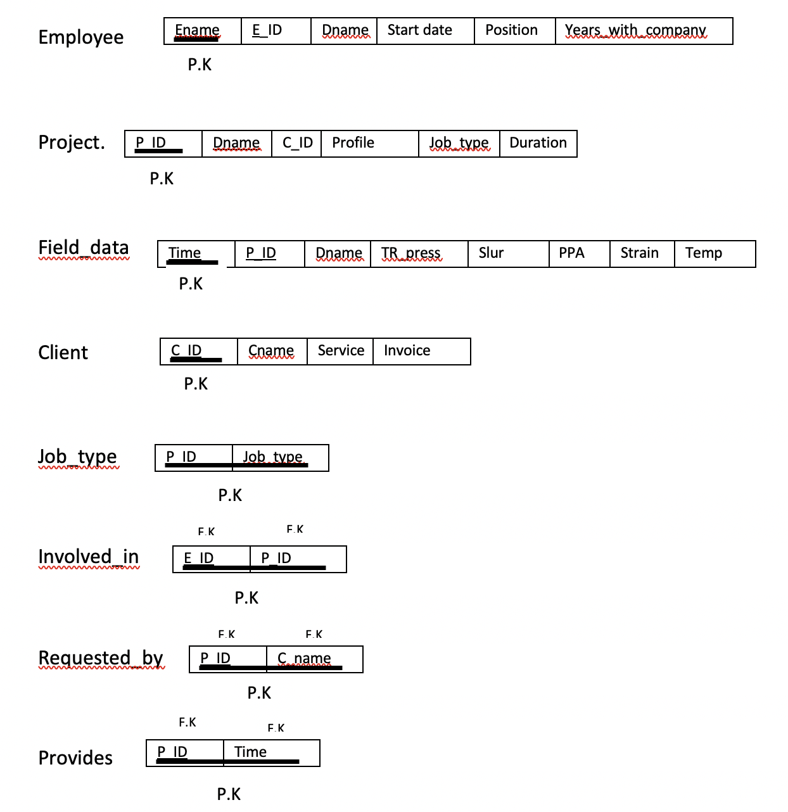
P.K and F.K structure and relations

Slide 5
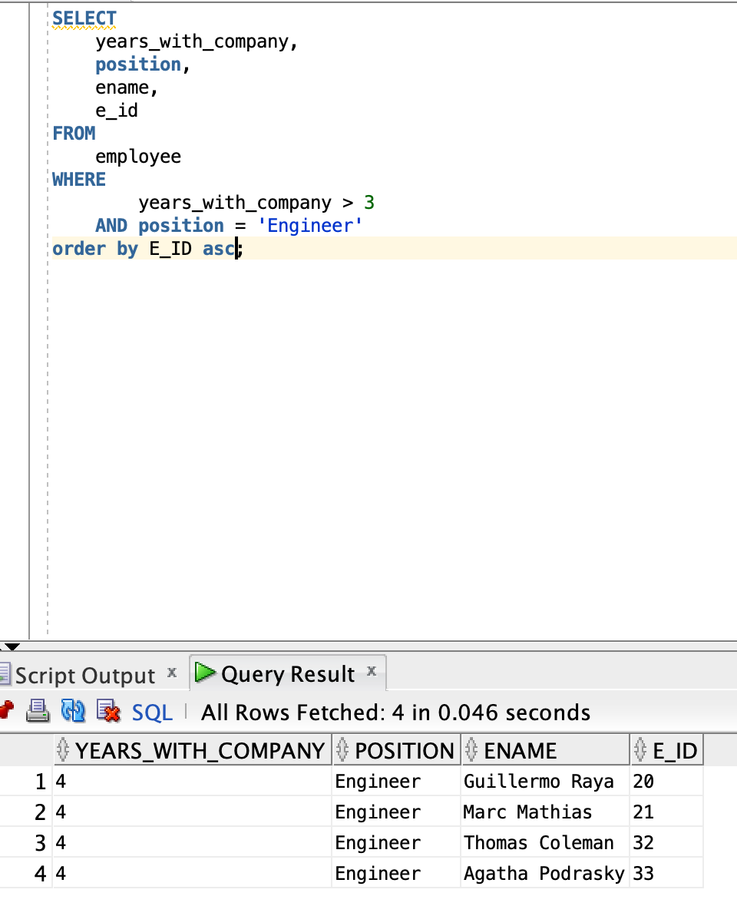

Complex queries
Q1. Find senior engineers who worked more than 3 years. Order by the ascending E_ID as lower E_ID means more seniority.
→Relational Algebra
$π$years_with_company>3 and position=’engineer’ (Employee)

Slide 6
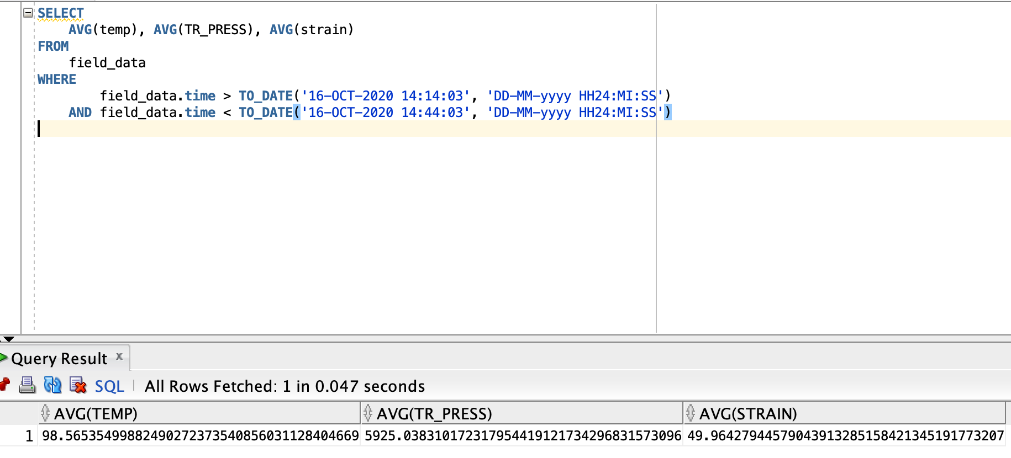

Complex queries
Q2. During the Apache(client) operation, we noticed a strong acoustic response for thirty mins from 2:14:03pm to 2:44:03pm. Find the average temperature, treating pressure and strain.
→Relational Algebra
R1→$π$time>16-oct-2020 14:14:03 and time<16-oct-2020 14:44:03 (Field_data)
$Gavg$_{Temp,TR_press,strain} R1

Slide 7
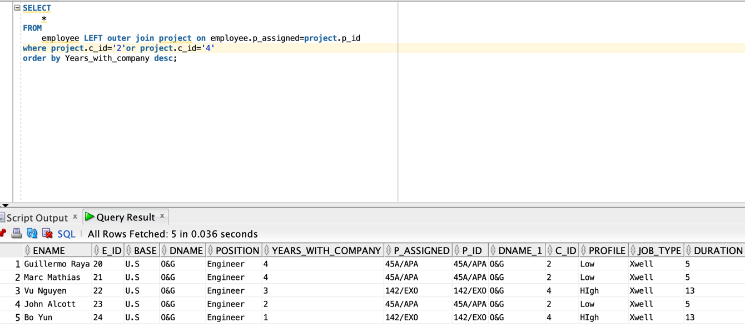

Complex queries
Q3. Give me a list of employees that were assigned for either Exxonmobil or Apache job and its duration.
→Relational Algebra
R1→ $π$time>16-oct-2020 14:14:03 and time<16-oct-2020 14:44:03 (Field_data)
$Gavg$_{Temp,TR_press,strain} R1

Slide 8
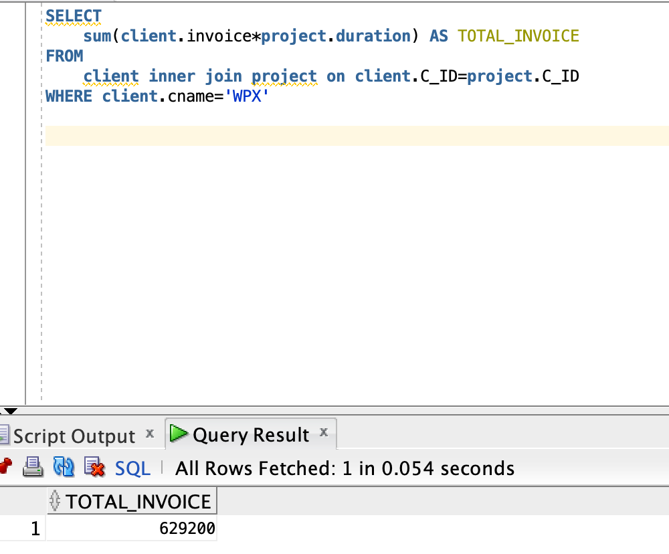
Complex queries
Q4. How much are we charging for service in total to WPX for all of WPX projects?
→Relational Algebra

Slide 9
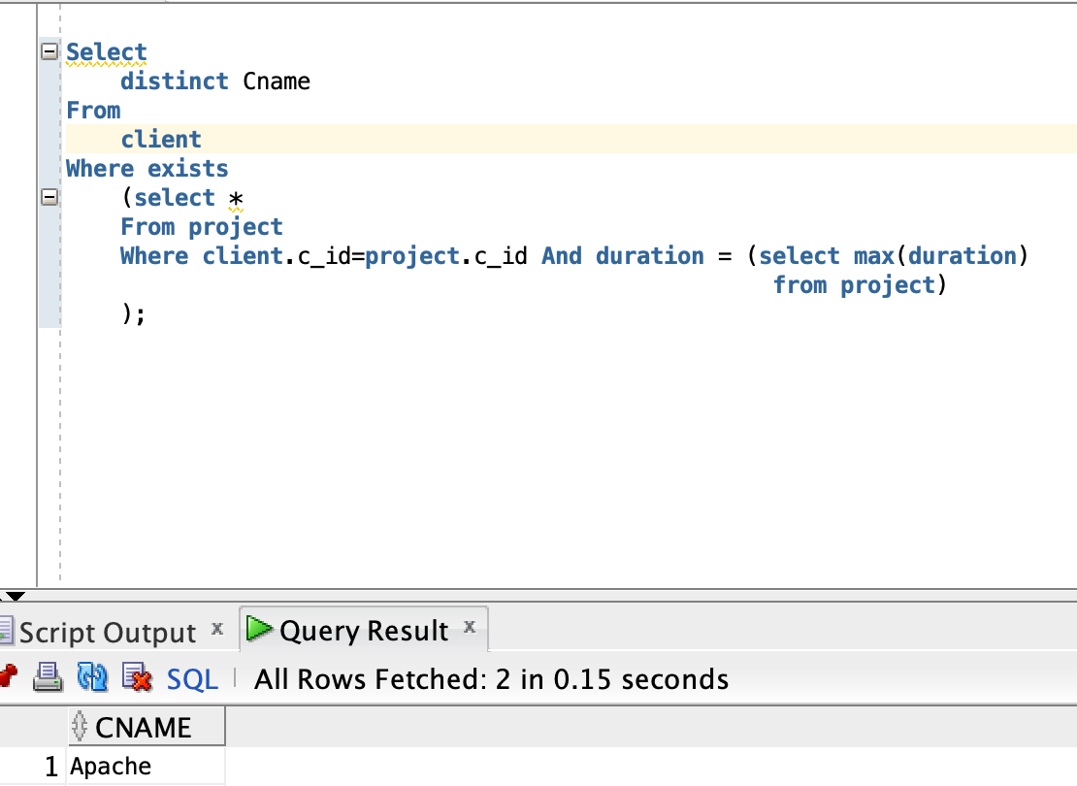

Complex queries
Q5. Give me the name of the client that has the longest job duration.
→Relational Algebra
R → F_{max(duration)}(Project)
$π$_{Cname} (Client * Project) natural join _{max(duration)} R

Slide 10
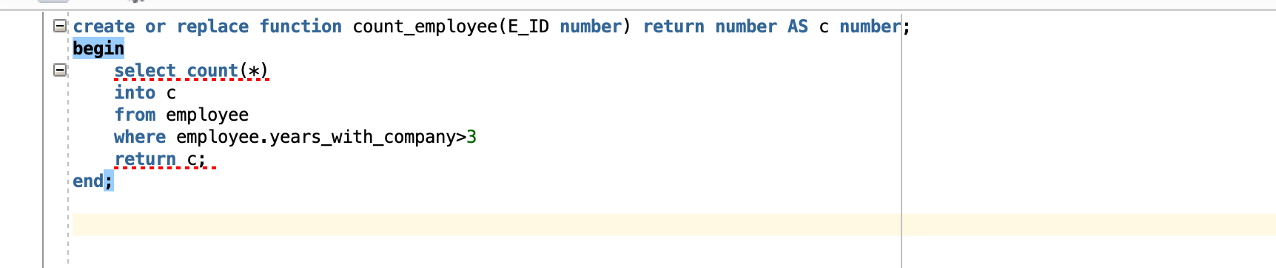
Stored function and precedures
Function
Q. Count the number of employees in the whole company

Slide 11
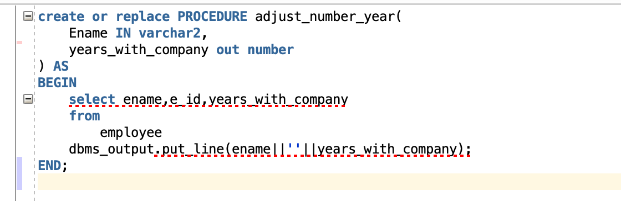
Stored function and precedures
Procedure1
Q. Take Employee name and years with company and put out a statement “Employee ___ has ___years with the company”

Slide 12
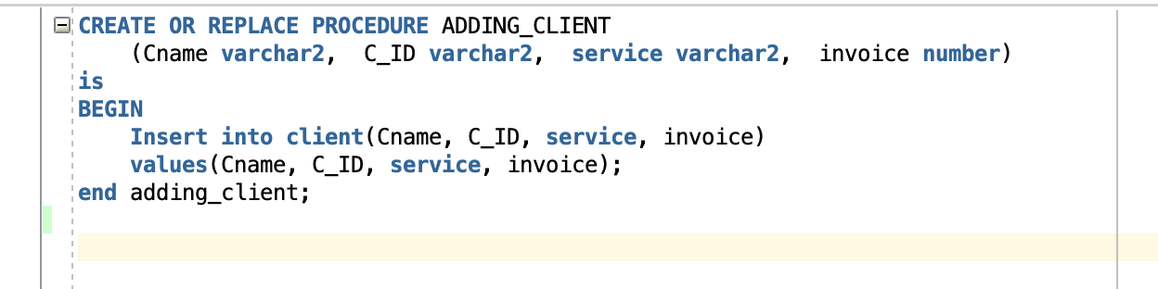
Stored function and precedures
Procedure2
Q. Write a procedure where I can add a new client information (Cname, C_ID, service, and invoice) to the client table.

Slide 13
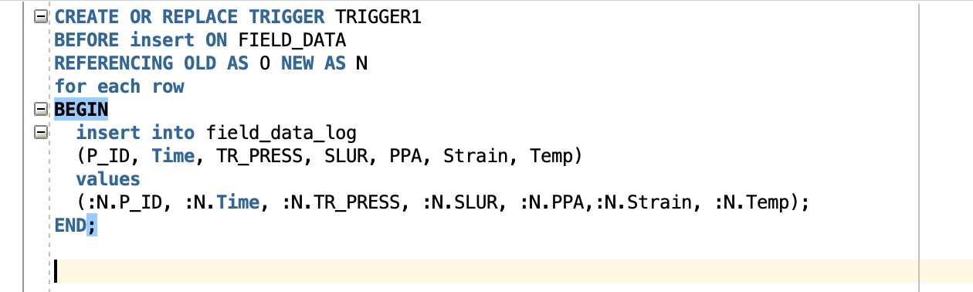
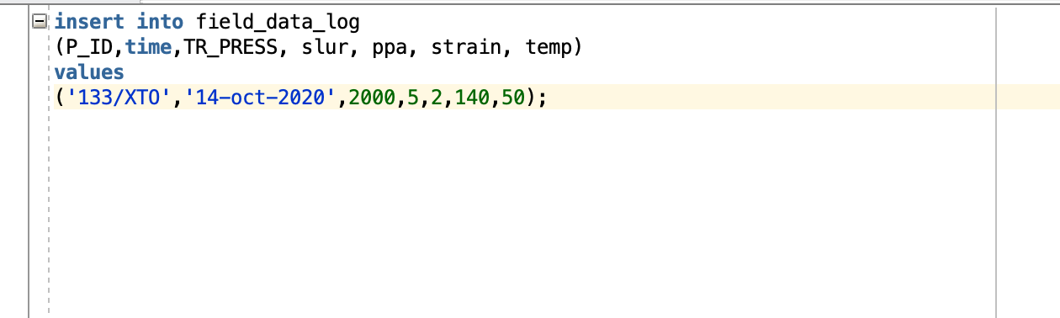
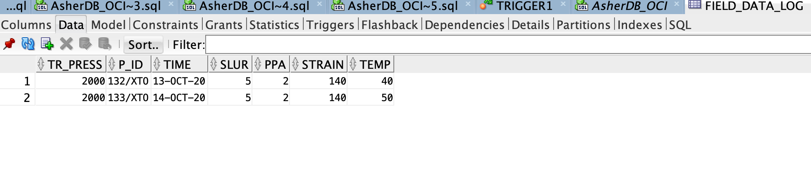
Triggers
Trigger1
Q. Write a procedure where I can add a new client information (Cname, C_ID, service, and invoice) to the client table.
Result: Performed twice

Slide 14
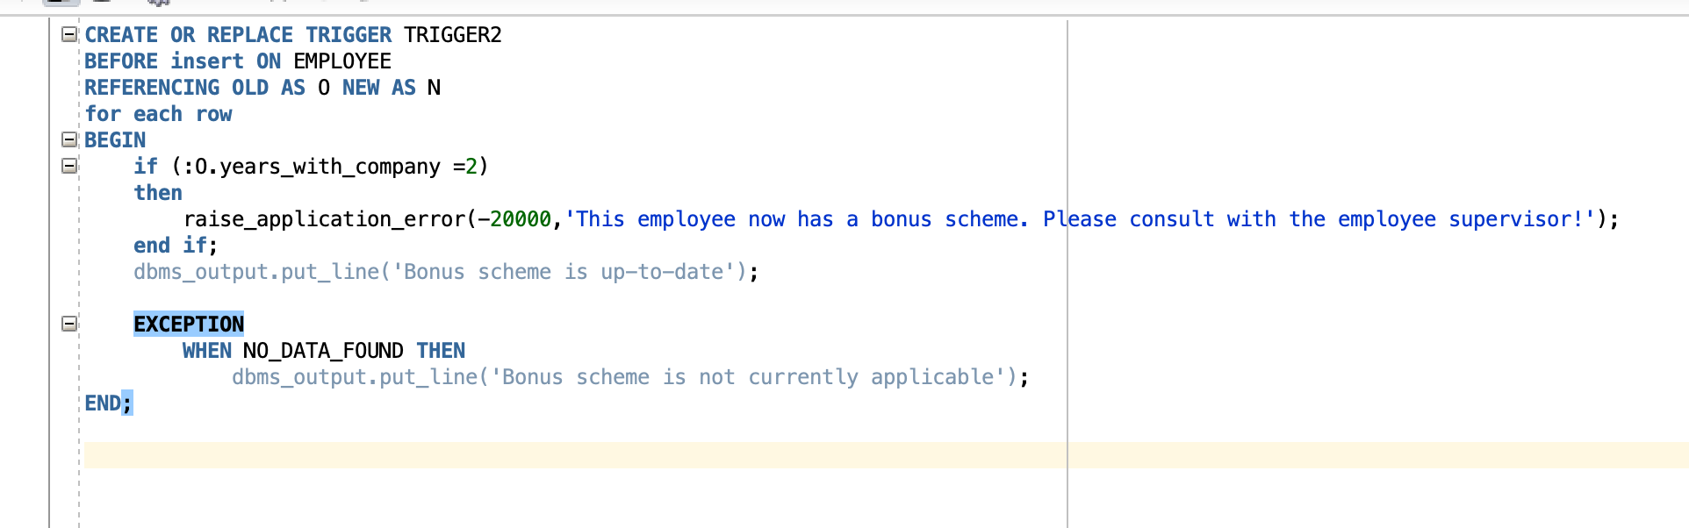
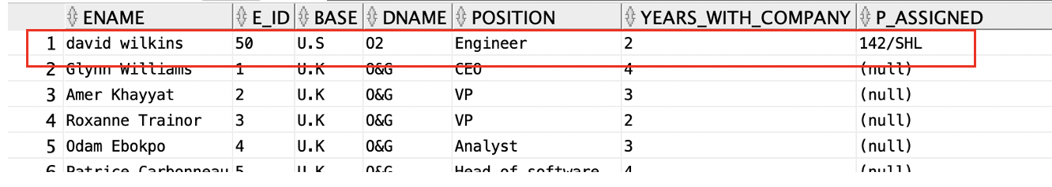
Triggers
Trigger2
Q. Before inserting a new set of data of an employee into the employee table, trigger an error alert when the employee has 2 years with the company. We have a bonus scheme for employees who worked 2 or more years. This is to ensure those with two more start getting bonuses starting on their second year with the company.
Result: It created an alert and inserted the following information

